Slide 1
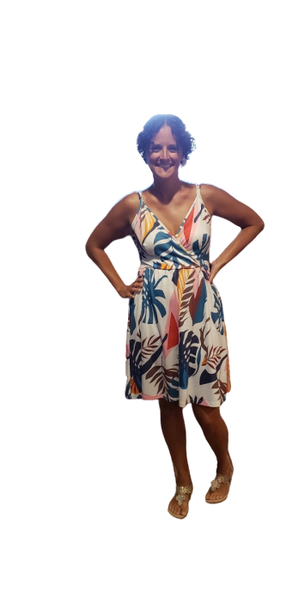
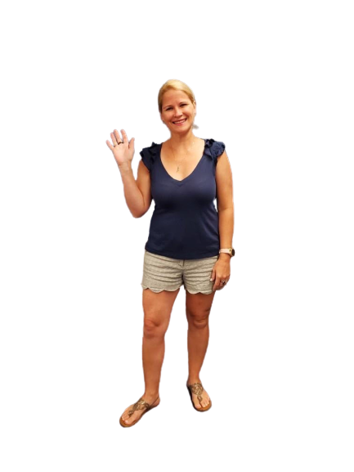
Mrs. Miller
to 3rd Grade
Mrs. Kempke
Mrs. Leslie

Slide 2
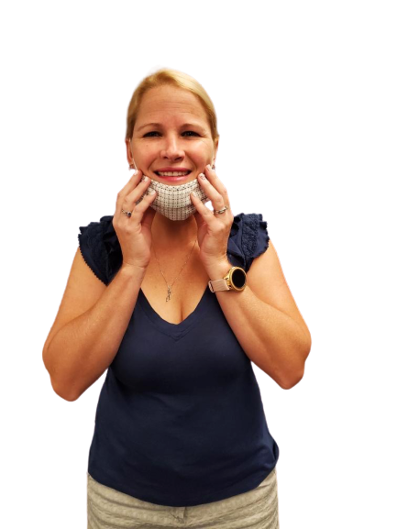
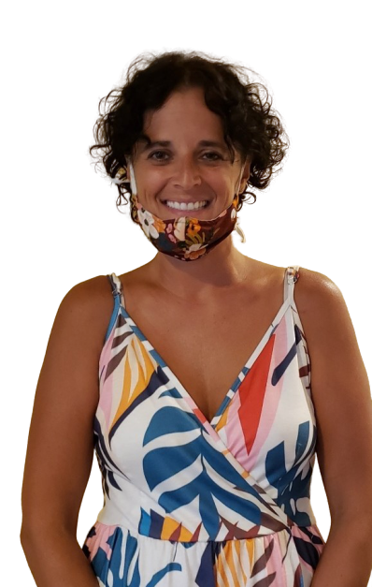
We are SO excited for this upcoming school year and can’t wait to see you in the classroom! We are going to have SO much fun and we can’t wait to meet you on August 17!!
(Always remember our smiling faces will be under these masks!)

Slide 3
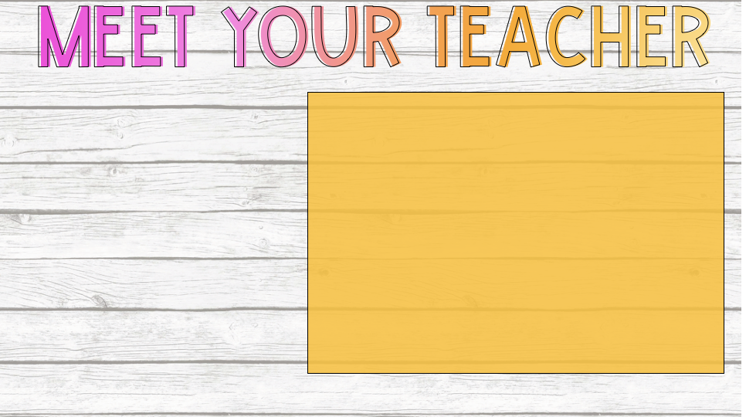
HELLO! I’m Mrs. Kempke and I am SO excited to be teaching you Math & Science this year! I am a proud graduate of the University of Northern Iowa! I have three Heathrow Knights of my own: Gavin (in 4th grade,) and Sawyer & Hadley (my twins in 2nd grade.) When I’m not in the classroom, my family and I love to go to the beach, enjoy DisneyWorld, have dance parties, play outside & watch college football…..GO IOWA HAWKEYES!!!
**Sending you lots of virtual hugs**

Slide 4
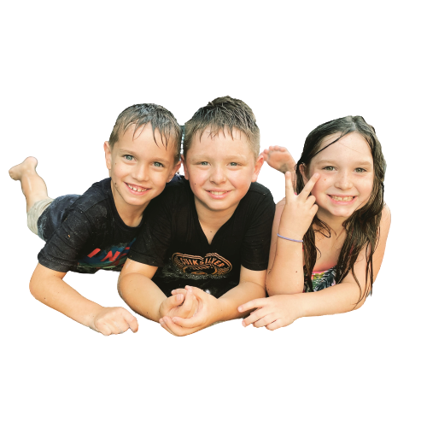
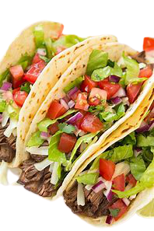
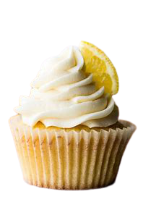
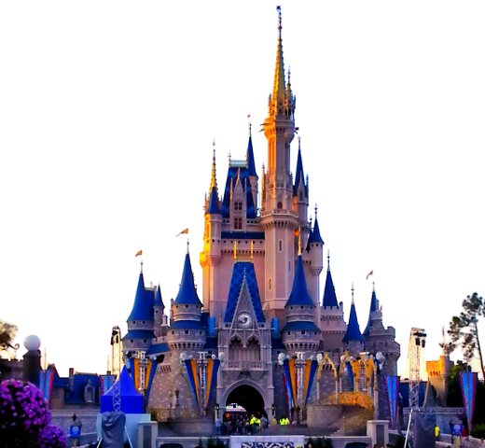
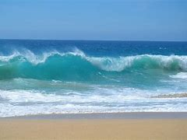
Some things Mrs. Kempke loves:

Slide 5
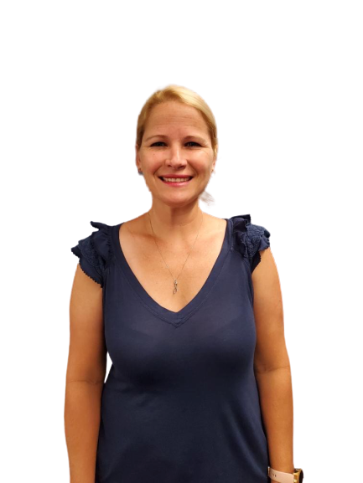
Hello, I’m Mrs. Leslie! I teach ELA & Social Studies. I graduated from University of Central Florida. GO KNIGHTS! I have two children here at Heathrow. Samantha is in 1st grade and Matthew is in Pre-K. I enjoy reading books and watching the Tampa Bay Buccaneers play football with Mr. Leslie.

Slide 6
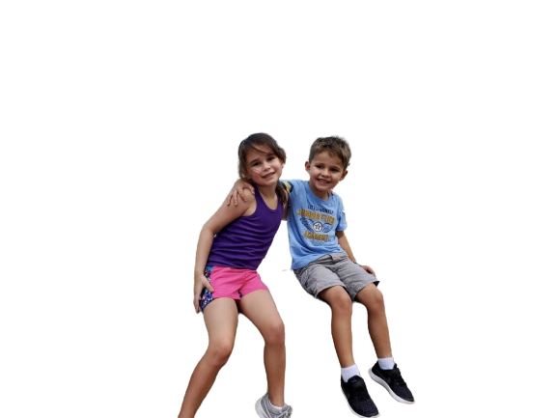
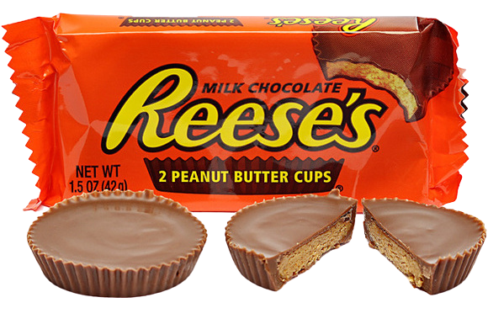
Some things Mrs. Leslie loves:

Slide 7
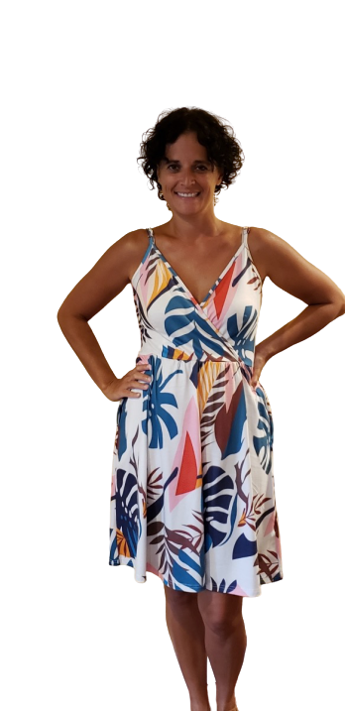
Hi, I’m Mrs. Miller & I will be teaching Math & Science. I graduated from Cedarville University with a degree in Elementary Ed & from UCF with a masters degree in Reading ed. This is my 22nd year teaching, & my 15th at Heathrow. I have 2 kids. An 11 year old girl named Ella & an 8 year old boy named William. My favorite things to do are play with my kids, play my violin, & cook with my daughter.

Slide 8
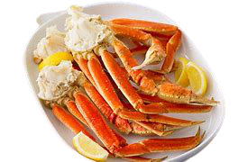
Some things Mrs. Miller loves:

Slide 9
courtney_kempke@scps.us
407.320.6841
erin_leslie@scps.us
407.320.6843
tanya_miller@scps.us
407.320.6841

