Slide 1
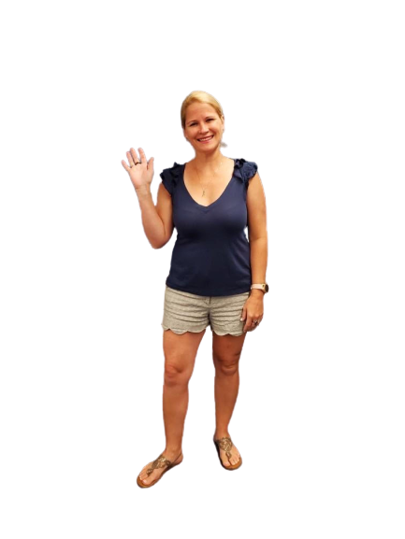
Welcome to the
3rd Grade with
Mrs. Leslie,
Mrs. Kempke,
& Mrs. Miller

Slide 2
“Equity through Excellence”
One Year’s Growth in One Year’s Time
Growth Mindset
Monitor with Feedback
Build Positive Relationships and Culture
Rigorous Instruction

Slide 3
GROWTH MINDSET
Instead of thinking…
This is too hard!
I give up!
I will keep trying and learn how to do this!
I always make mistakes!
Think…
This may take more time and effort!
Mistakes help me improve!

Slide 4
Take Home Folders
Take Home Folders should come to school DAILY.
Graded papers will be sent home in the “To Be Left at Home” pocket of the Take Home Folder. If your child happens to score a “D or F” on a test, you will find it in the “Bring Right Back” pocket with a “please sign and return” stamp.
Please review ALL papers with your child on a daily basis.
Spelling and vocabulary words can be found in the page protector of the Take Home Folder.

Slide 5
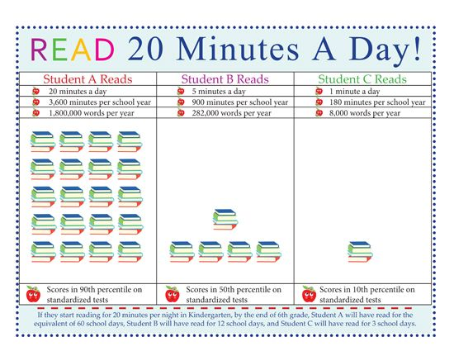
ELA & Social Studies Homework
Daily reading homework- students should be reading a book of interest at their ability level for at least 20 minutes a day. Please record minutes in planner (bottom yellow box labled “reading minutes” on a daily basis * please let me know if & when they are ready to take an AR Quiz to show comprehension of the book.
Spelling & Vocabulary practice is flexible. We have been reviewing multiple ways to practice, including Google Slides on our Google Classroom, flash cards, & writing in their spiral notebooks.
As we introduce new Social Studies skills you will find vocabulary in the Take Home Folders. Vocabulary and Google Slides will be posted to Google Classroom for review of content learned in class.

Slide 6
Math & Science Homework
Homework will be written in the planner daily. Due to our “alternating days” schedule, for Pandemic safety, students will be assigned math practice pages from their Go Math Student Practice Workbook. It will be checked in class on the day they have Mrs. Kempke/Mrs. Miller. (Odds OR evens will be assigned).
Most Math and Science lessons are uploaded to our Math/Science Google Classroom. Students also have access to their “Go Math Student Workbook” and Practice Workbook in their Portal.
*If your child is ever absent or forgets/misplaces their workbook, they can find their math pages on their “Think Central” app.
As we introduce new Science skills you will find vocabulary in the Take Home Folders. Vocabulary and Google Slides will be posted to our Math/Science Google Classroom for review of content learned in class.

Slide 7
Communication
Email and planners are the best forms of communication.
Please review papers that come home in the “Take Home” folder daily.
We ask that you please check planners for homework, notes written, and record reading minutes before signing.
Thank you! ☺

Slide 8
Transportation
Changes in transportation home must be in writing (planner is fine) .
In case of an emergency change (once your child is already at school) please contact the FRONT OFFICE (407-320-6850).
Please do NOT leave any messages on voicemail regarding transportation!

Slide 9
Curriculum
Based on….
Language Arts Florida Standards (LAFS)
Mathematics Florida Standards (MAFS)
Science (NGSSS)
Social Studies (NGSSS)

Slide 10
ELA (Reading & Lang. Arts)
Reading
Phonemic Awareness
Phonics
Fluency
Vocabulary
Comprehension
Language Arts
Spelling
English - grammar, proofreading/editing, punctuation, capitalization, word usage
Writing
Cursive Handwriting

Slide 11
SOCIAL STUDIES
Taught weekly & integrated in ELA
History
Civics
Economics
Geography

Slide 12
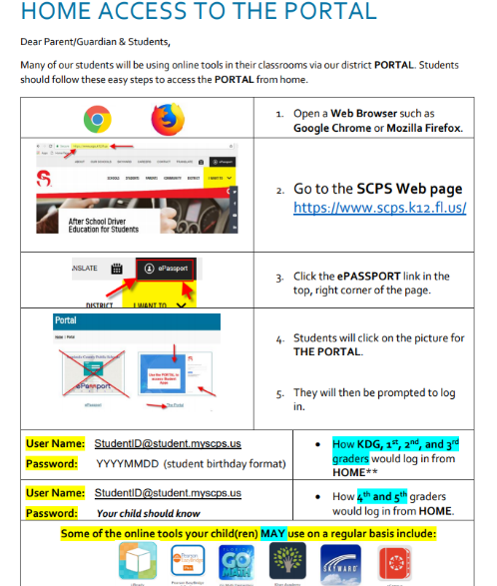
A web based tool to help students make real gains in Reading and Mathematics. It includes assessments which measure students’ growth and performance through personalized instruction.
Portal access from scps website:

Slide 13
Progress Monitoring
Our Progress Monitoring will be assessments and teacher observations.
FSA (Florida Standards Assessment) will be administered in the spring (early April for Reading FSA & early May for Math FSA) FSA is aligned to our Florida Standards. We will have more information available later in the year. There will be an FSA Information Night after the new year (2021). Last year’s FSA PowerPoint is posted to our 3rd Grade Weebly homepage: www.heathrowthirdgrade.weebly.com

Slide 14
MATH
Emphasis on use of manipulatives and higher-level thinking skills
Consumable books
On-line resources on “Think Central Go Math (Elementary)”
Memorize multiplication facts 1 through 12

Slide 15
SCIENCE
Bodies of Knowledge:
Physical, Earth, and Life Science
Taught daily
Labs / activities
Use of scientific method
Tested in 5th grade on FCAT
Consumable books

Slide 16
For our health & safety during the Pandemic…
Masks should be worn at all times on campus with the exception of lunch and recess or when socially distanced. We suggest a spare mask be put in your child’s backpack.
We are unfortunately unable to have Dividends on campus at this time. We still encourage parents to register as a Dividend: https://dvd.scps.k12.fl.us/
Parents are unable to join their students for lunch on campus until further notice.
No birthday treats can be brought to school & shared.
Field trips will not be schedule this school year until further notice.
Conferences will be held virtually via Google Meet or phone towards the end of Quarter 1.

Slide 17
Questions?
If we were not able to answer your questions with our Curriculum Night Google Slides, please email them to all 3 of us or “pop on” to our 3rd Grade Curriculum Night Q & A any time from 7:00pm-7:30pm on Thursday, August 27th.

